Slide 1
Foundation of Data Science: Project Report (Example)
Zhe Yu
Introduction to Data Mining, 2nd Edition
by
Tan, Steinbach, Karpatne, Kumar

Slide 2
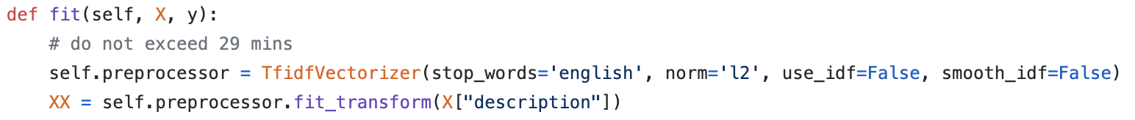
Preprocessing
Only use the ‘description’ column
This column contains most valuable information for predicting fake job posts.
Drop other irrelevant/less useful information for easier training and better performance.

Slide 3
Preprocessing
Featurization
Remove stop words
Term frequency as features
L2 normalization on rows

Slide 4
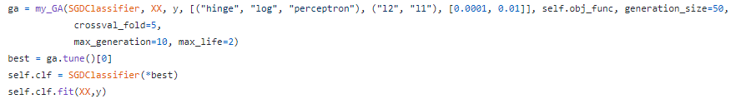
Model Training
SGDClassifier with Tuning
hinge loss: linear SVM
log loss: logistic regression
perceptron loss: perceptron

Slide 5
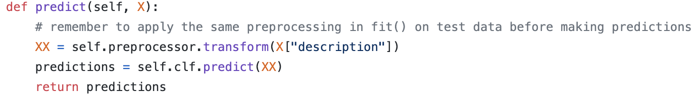
Prediction
Apply the preprocessor and learned model to predict whether a news is fake or not.

Slide 6
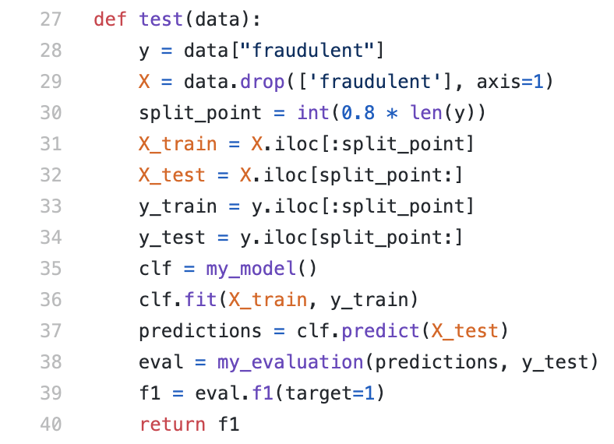
Model Evaluation
Evaluate with a holdout set.
F1 score: 0.696
Runtime: 26.9 min

